Slide 1


Eclipse set-up
TIS – KIM YONGHOO
CyberLogitec Co., Ltd.
Nuritkum Square R&D Tower, 16th Fl.1605 Sangam-Dong,
Mapo-Ku,Seoul 121-795, Korea
Tel +82 2 6350 2473 Fax. +82.2.6350.2052
www.cyberlogitec.com

Slide 2
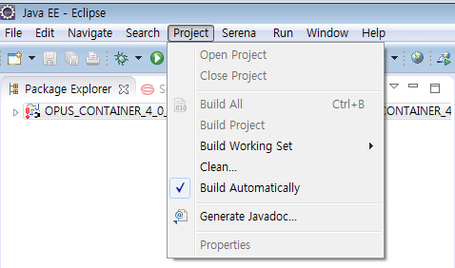
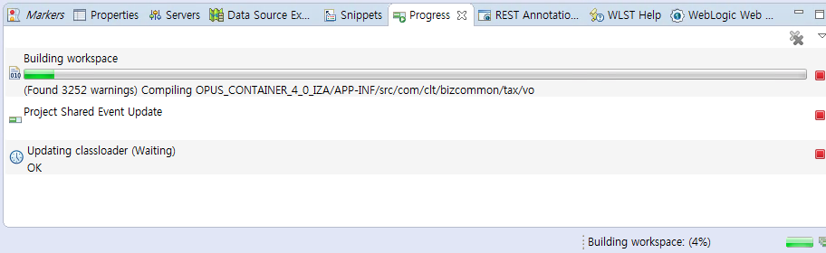
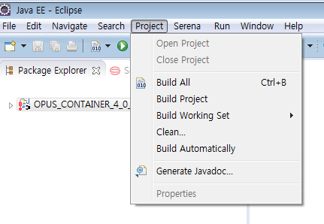
3. Build source code
If checked build Automatically
If unchecked, click “Build All”

Slide 3
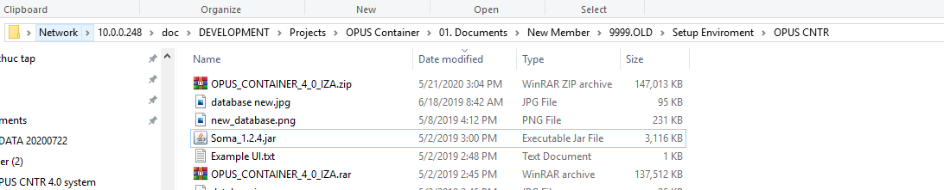
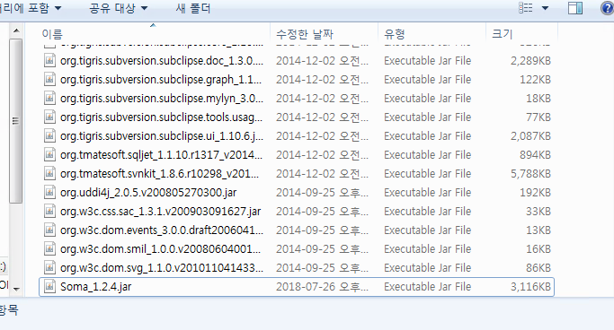
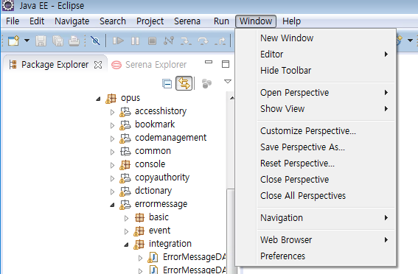
4. Set Synapse IS
Soma_1.2.4.jar
Directory: {ECLIPSE_HOME}/plugins/

Slide 4
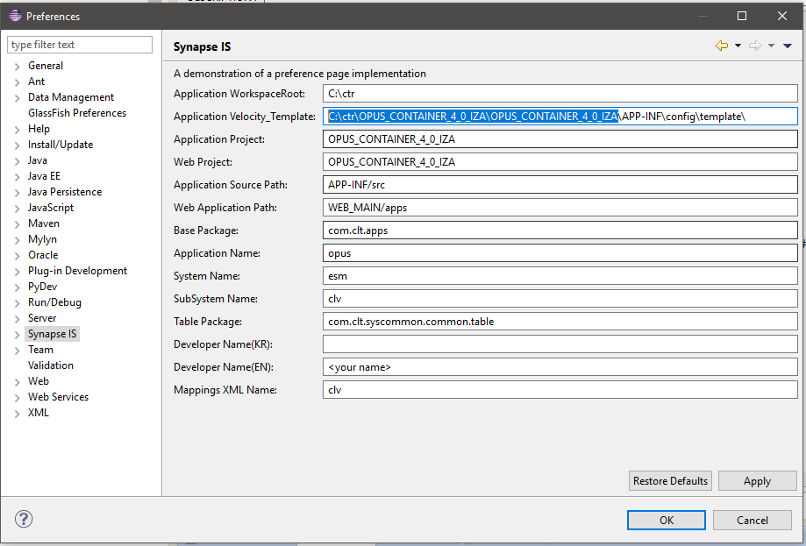
4. Set Synapse IS

Slide 5
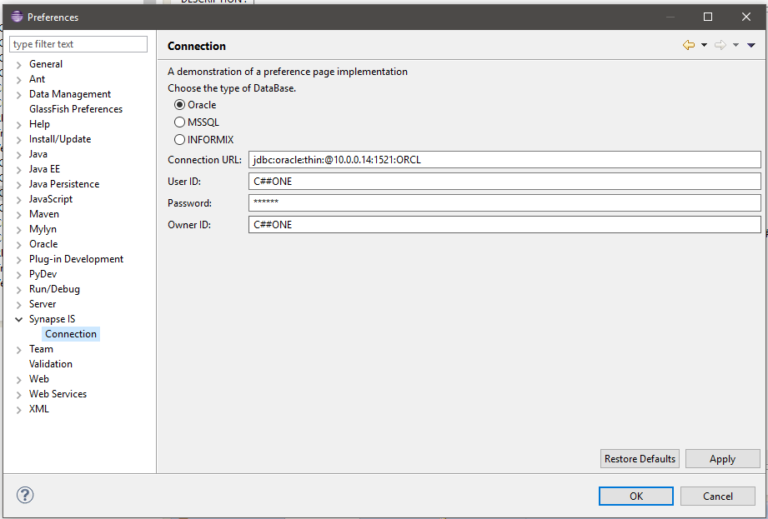
4. Set Synapse IS
C##ONE

Slide 6
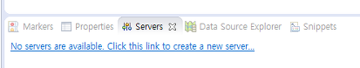
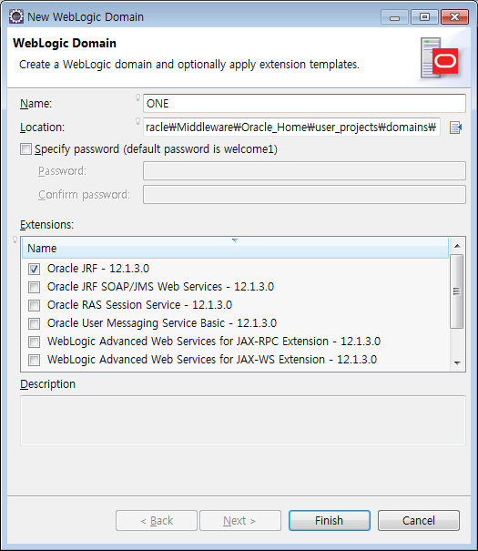
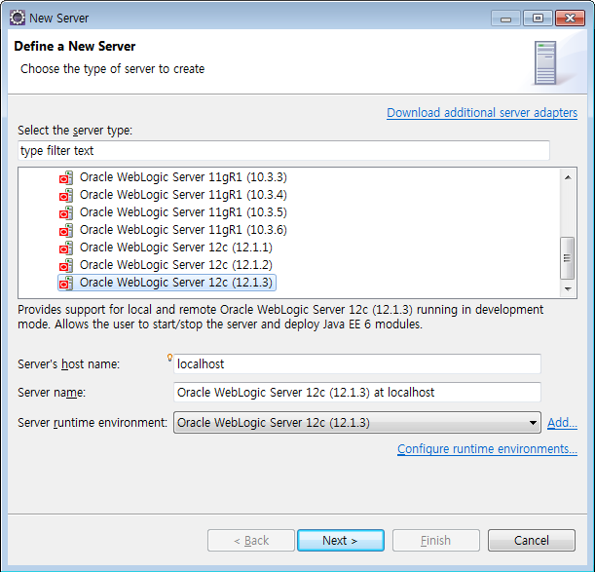
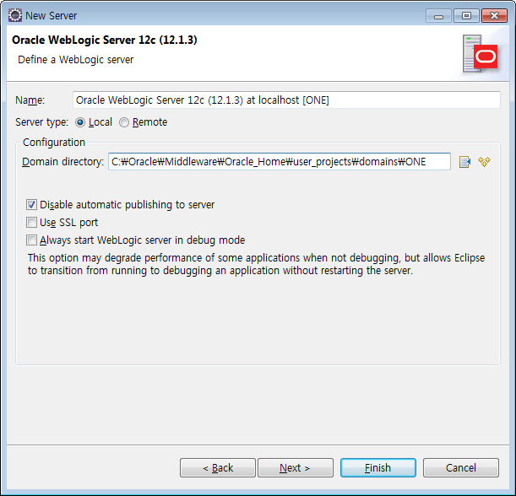

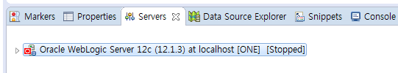
5. Create a server
1
6
2
4
5
7
3

Slide 7
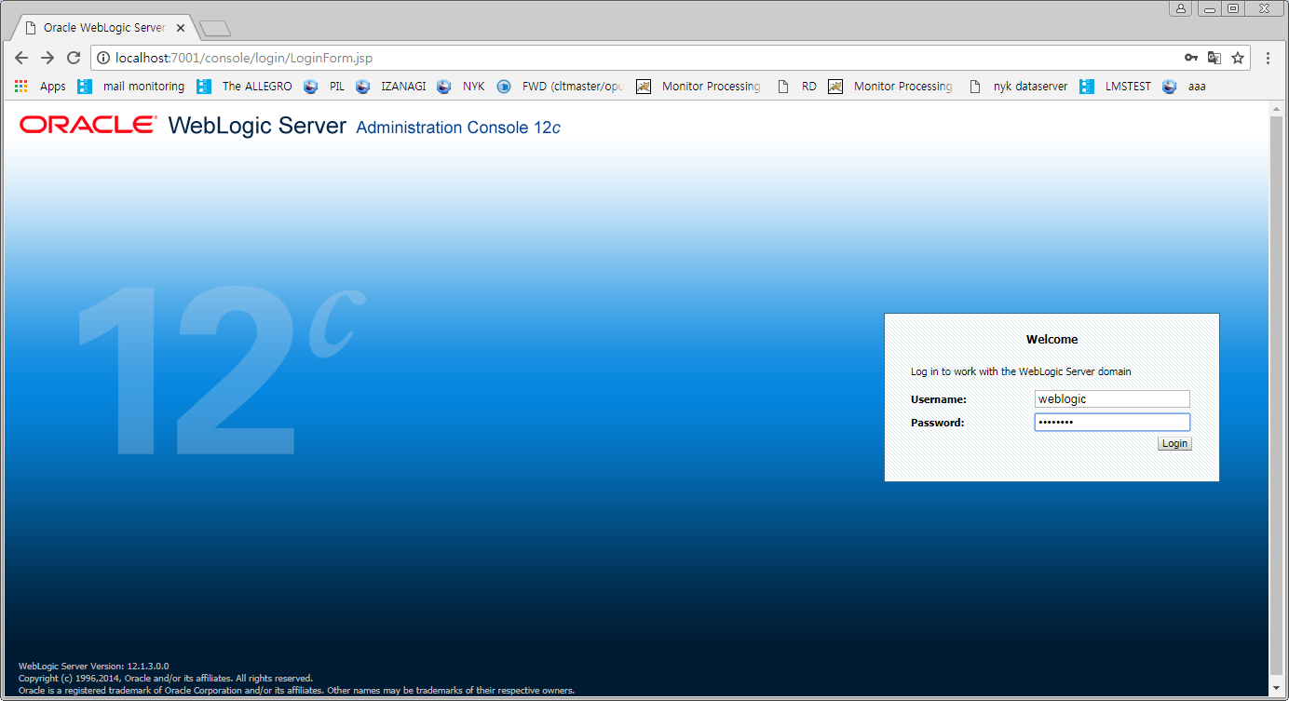
6. Connect database
weblogic
welcome1

Slide 8
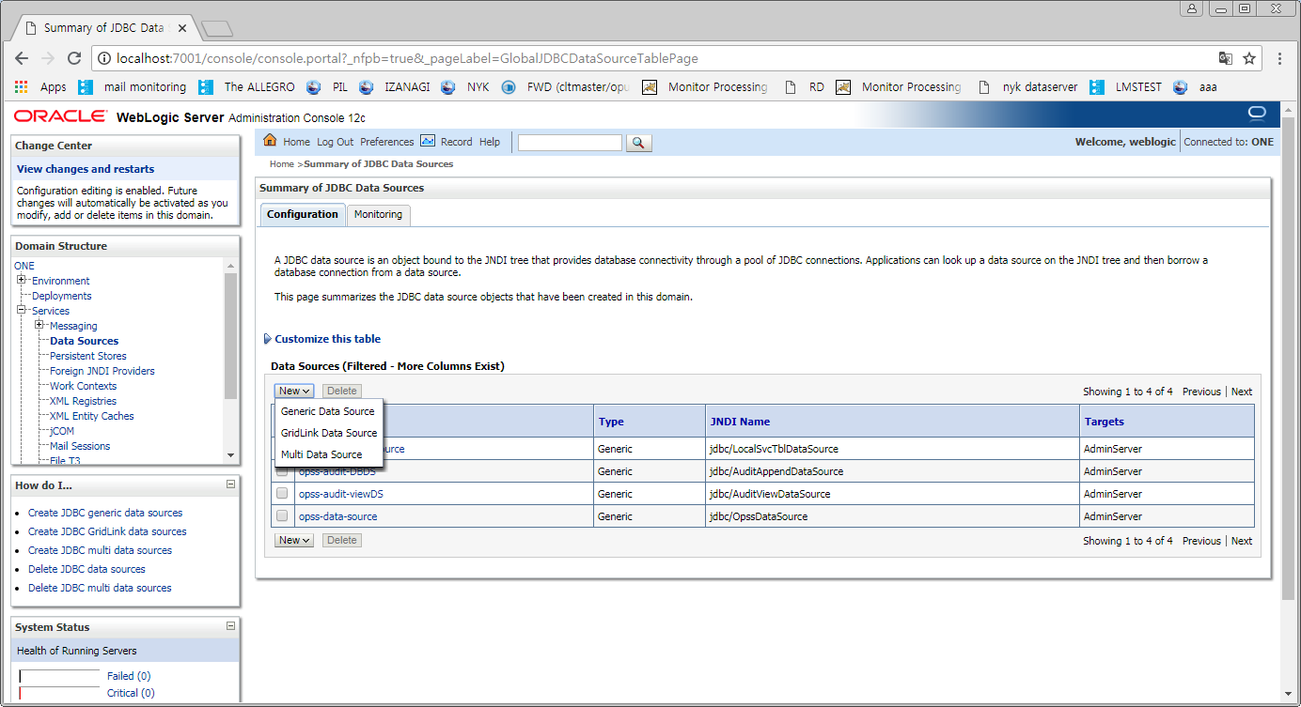
6. Connect database
1
2

Slide 9
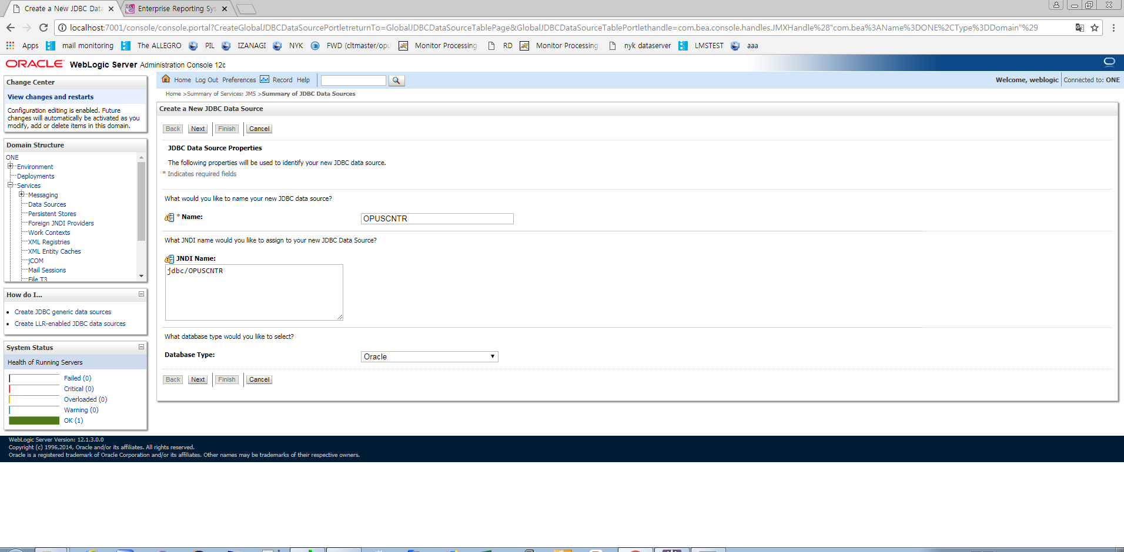
6. Connect database
1
2
3

Slide 10
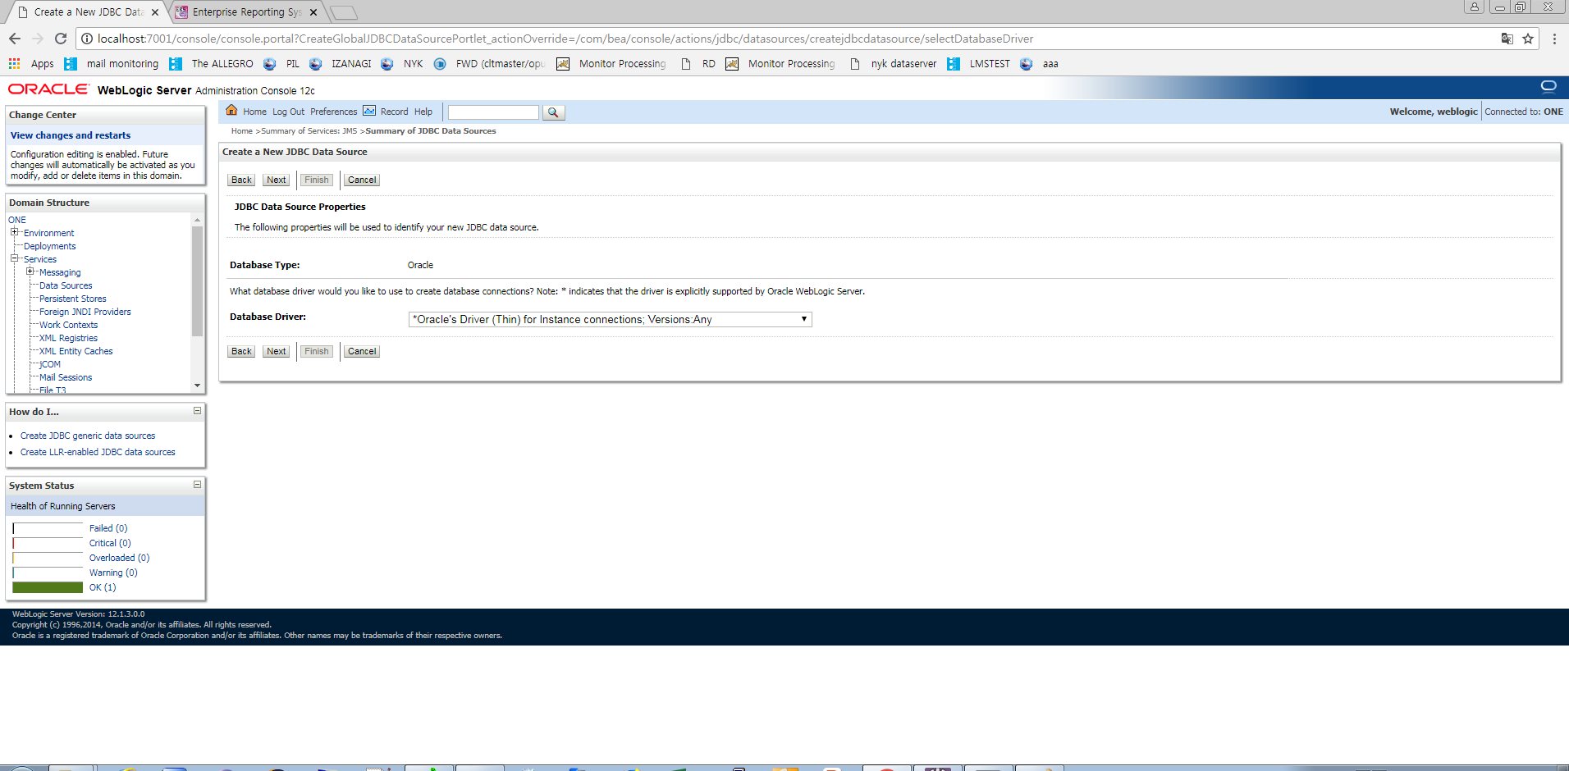
6. Connect database
1
2

Slide 11
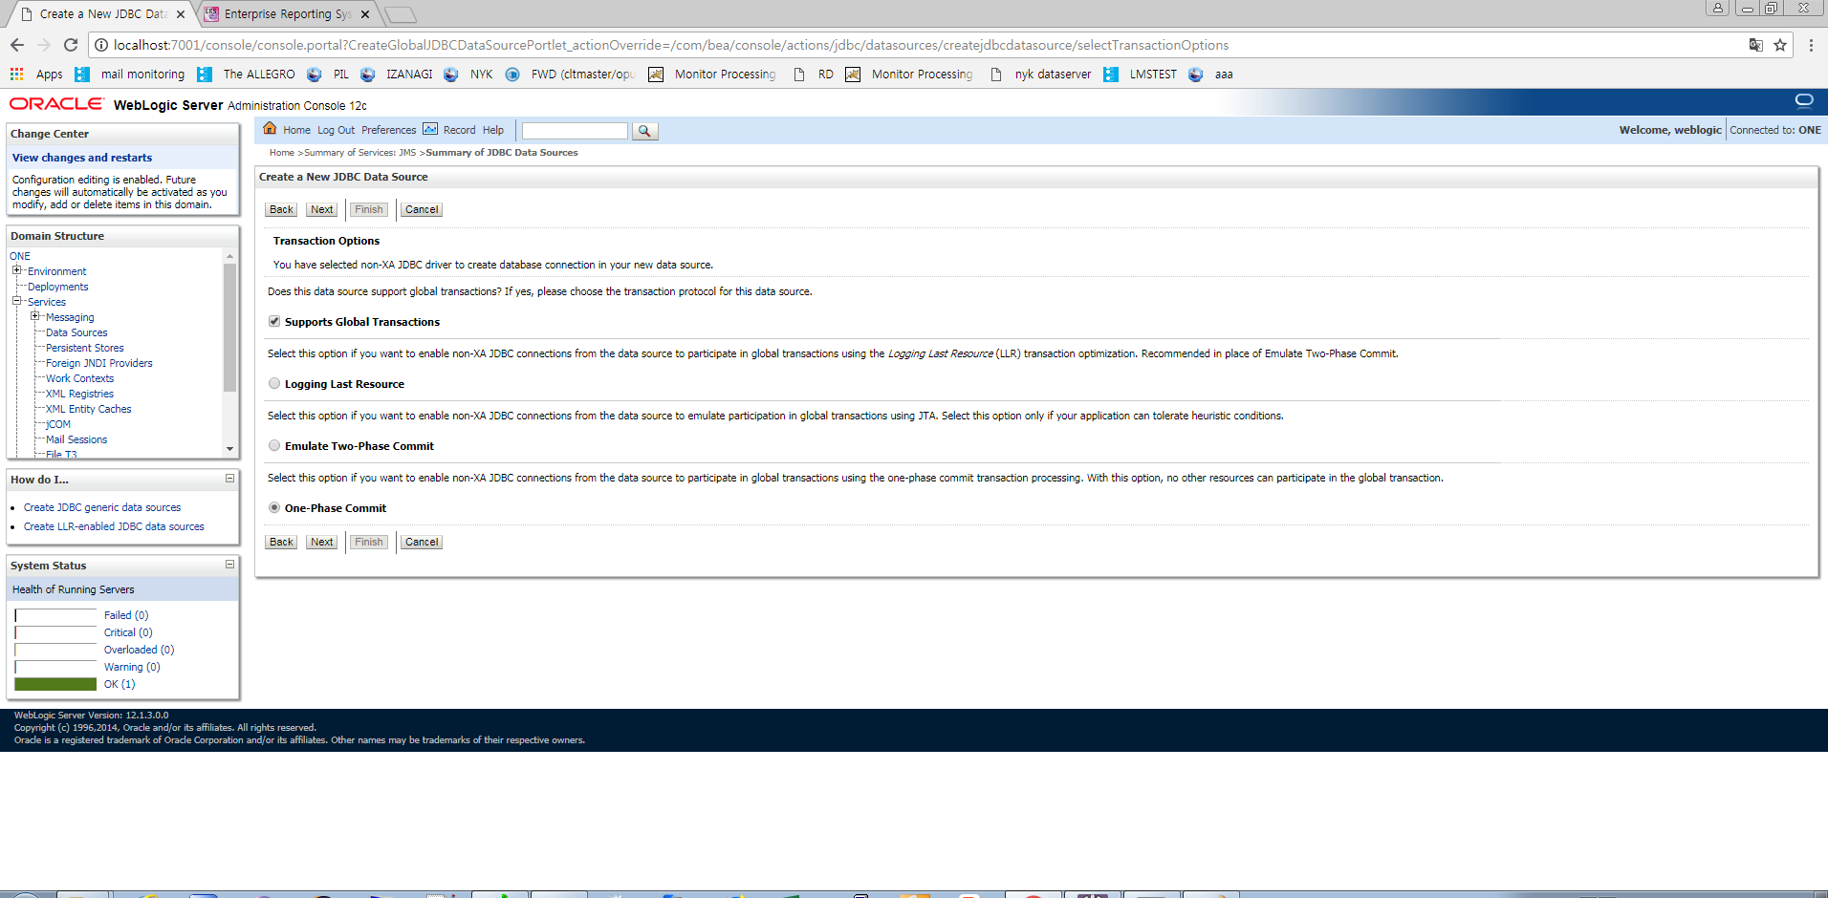
6. Connect database
1

Slide 12
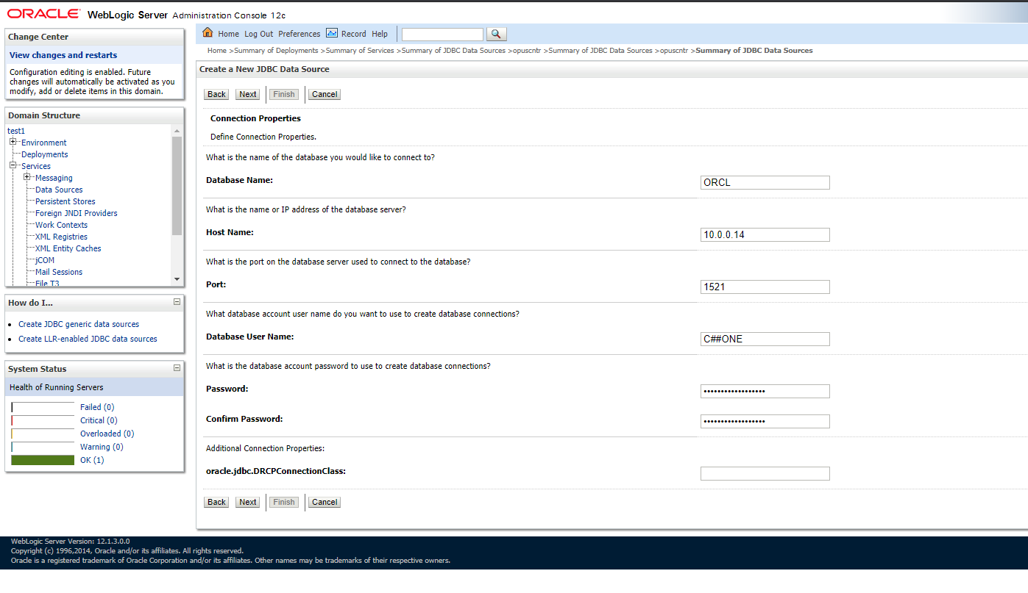
6. Connect database
1
ORCL
10.0.0.14
1521
C##ONE
C##ONE
C##ONE
2

Slide 13
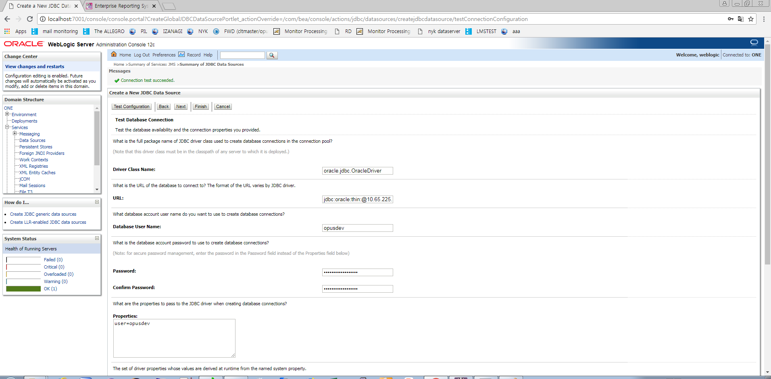
6. Connect database
2
1

Slide 14
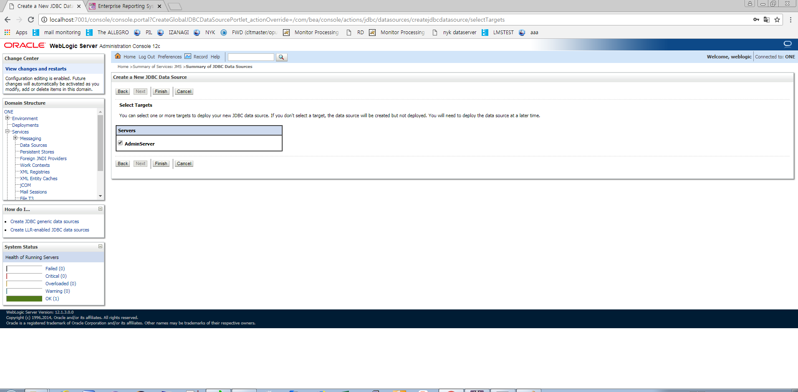
6. Connect database
1
2

Slide 15
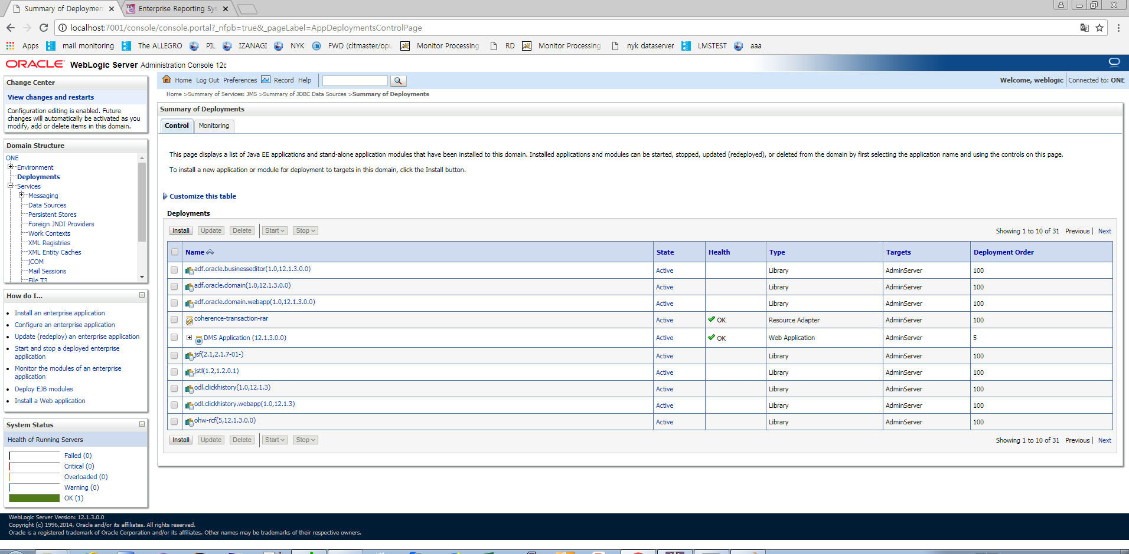
7. Deploy source code
1
2

Slide 16
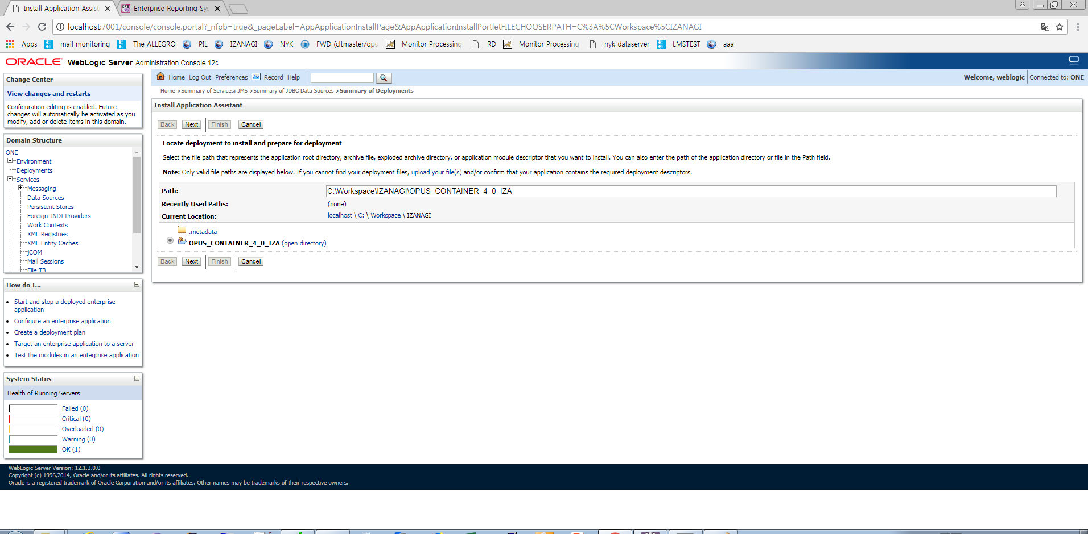
7. Deploy source code
1
2

Slide 17
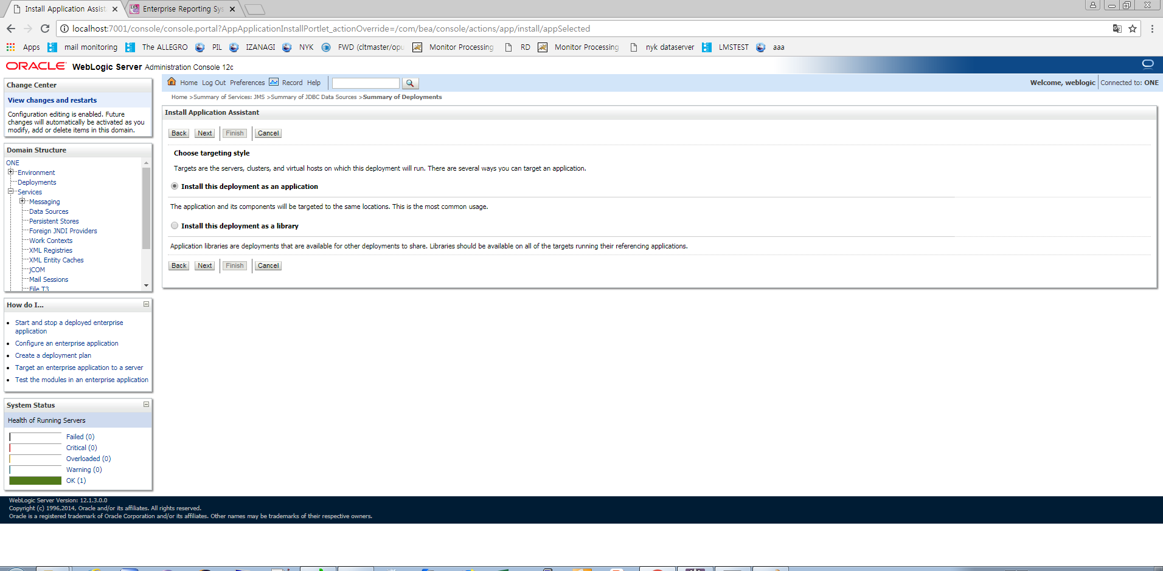
7. Deploy source code
1

Slide 18
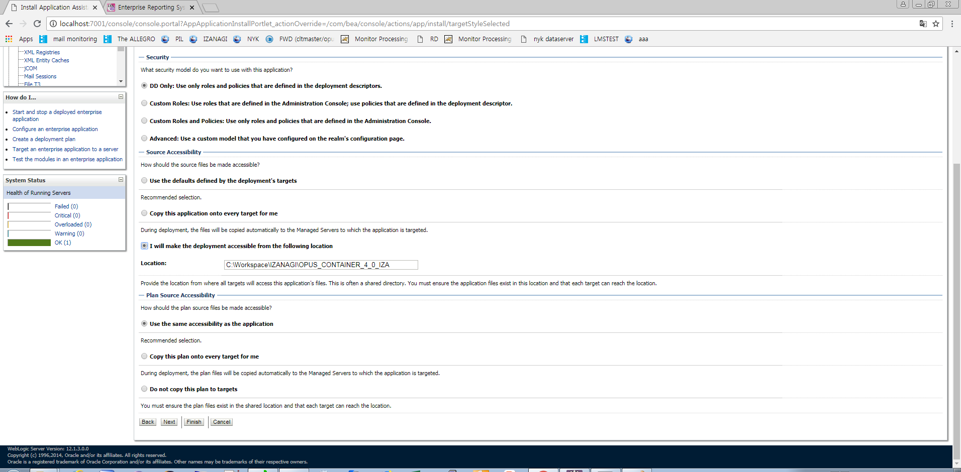
7. Deploy source code
1
2

Slide 19
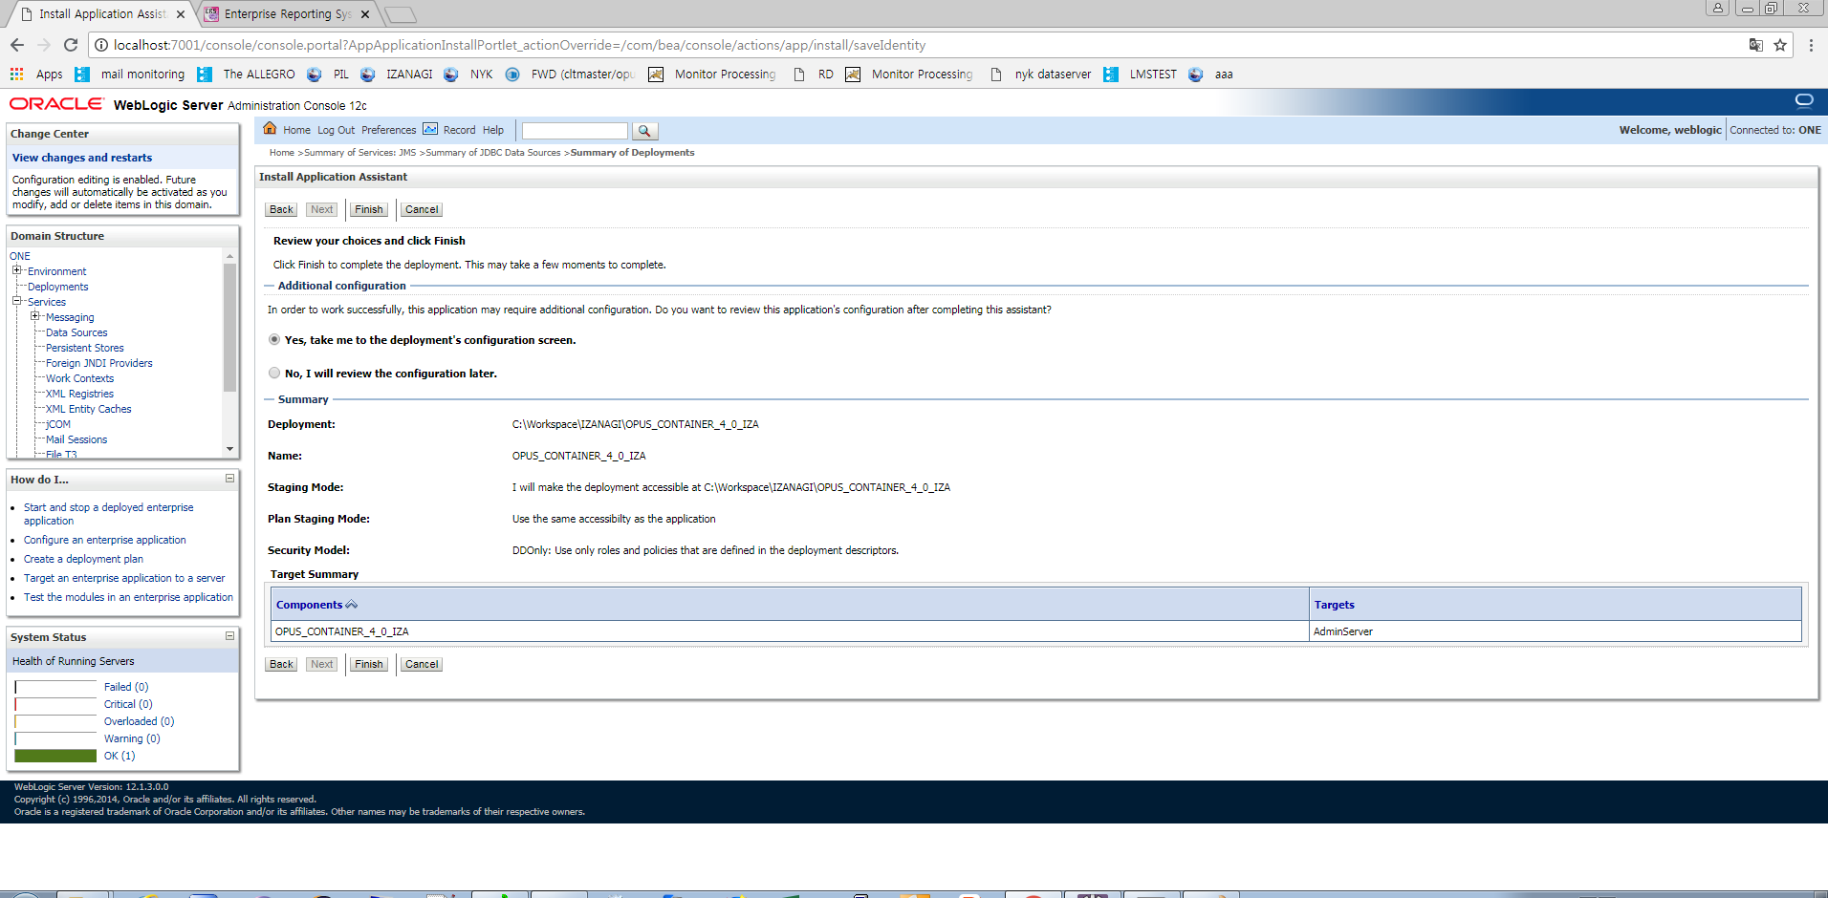
7. Deploy source code
1

Slide 20
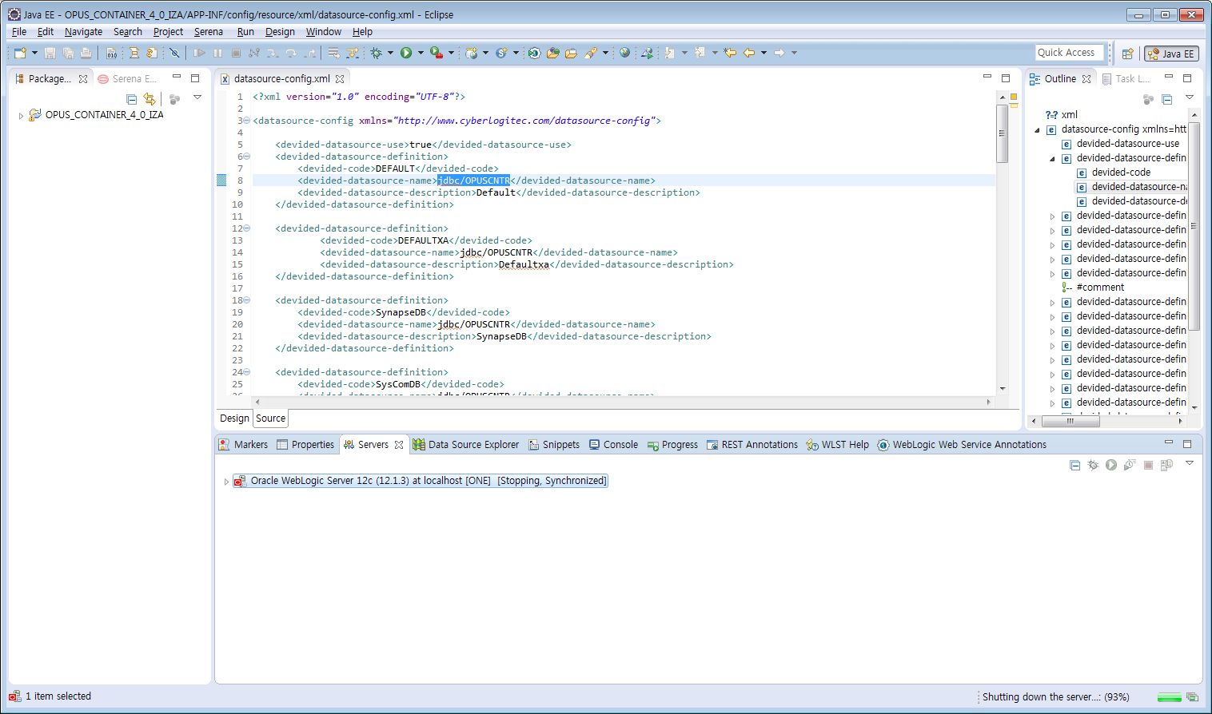
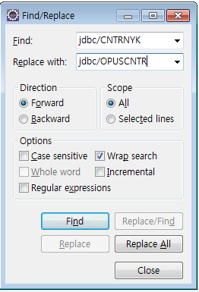
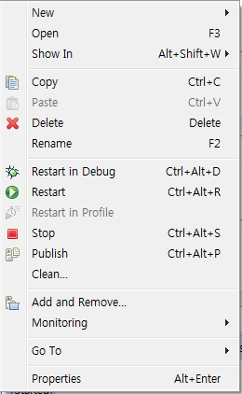
8. Modify datasource-config.xml
jdbc/CNTRNYK -> jdbc/OPUSCNTR
Source is now ready.

